Slide 1
Gauss’ Law
Gauss’ law and Coulomb’s law
Applications of Gauss’ law

Slide 2
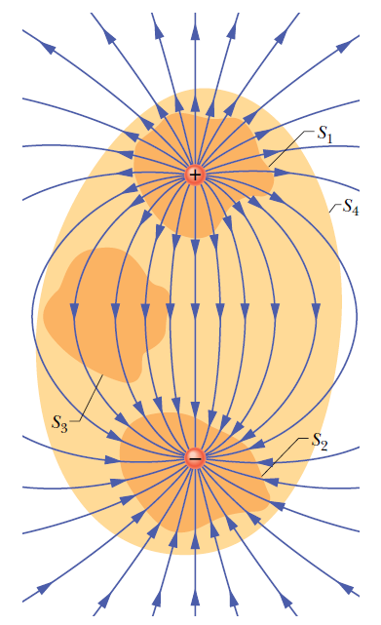
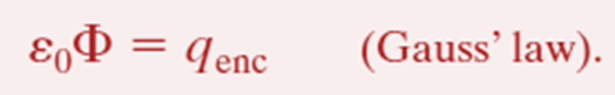
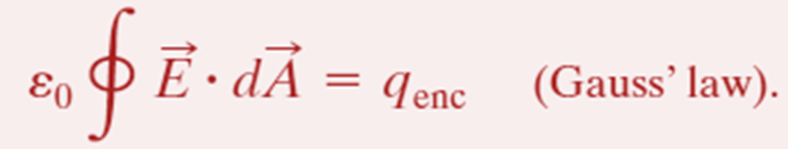
Gauss’ Law:
The net charge q_{enc} is the algebraic sum of all the enclosed positive and negative charges, and it can be positive, negative, or zero.
The electric field at the surface is due to all the charge distribution, including both that inside and outside the surface.

Slide 3
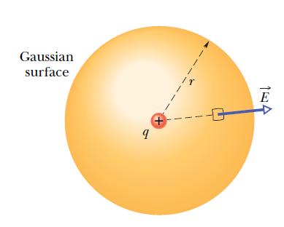


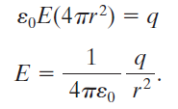
Gauss’ Law and Coulomb’s Law:
One may also derive Gauss’ law from Coulomb’s law.
These two laws are equivalent.

Slide 4
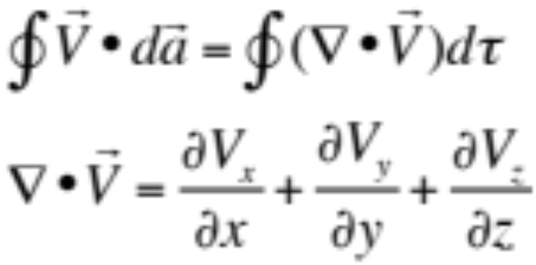
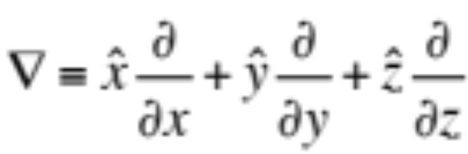
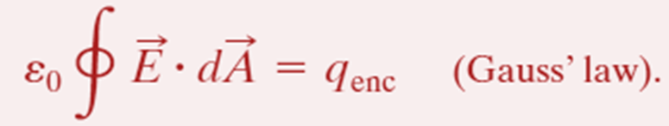
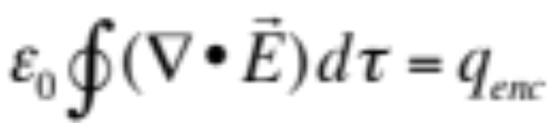

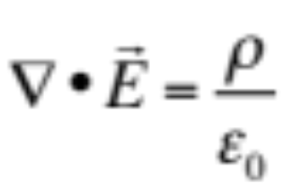
(Gauss theorem in vector analysis)
(Gauss’ law in differential form)

Slide 5
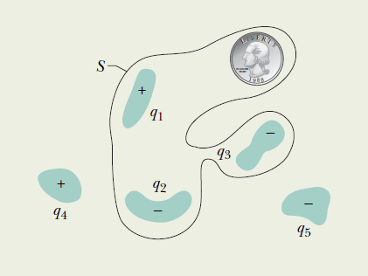
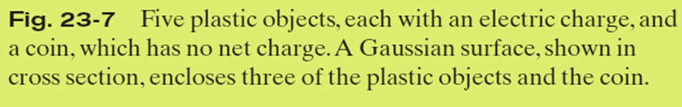
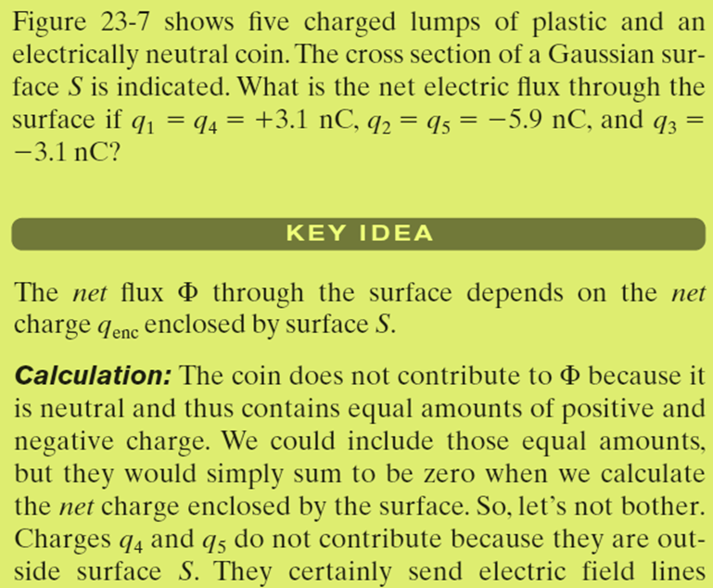
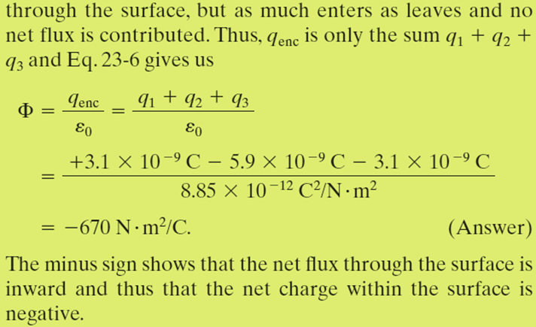
Example, Relating the net enclosed charge and the net flux:

